Slide 1
CSEE5590/490 Big Data Programming Lesson 4- Hive

Slide 2
Agenda
Motivation
Overview
Architecture
Application
Cons and Pros
Data Model / Metadata
Related Work

Slide 3

Data Analysts with Hadoop

Slide 4
Hadoop MR
MR is very low level and requires customers to write custom programs
HIVE supports queries expressed in SQL-like language called HiveQL which are compiled into MR jobs that are executed on Hadoop
Hive also allows MR scripts
It also includes MetaStore that contains schemas and statistics that are useful for data explorations, query optimization and query compilation

Slide 5
Motivation
Limitation of MR
Not Reusable
Error prone
For complex jobs:
Multiple stage of Map/Reduce functions
Just like ask dev to write specify physical execution plan in the database

Slide 6
Motivation
Yahoo worked on Pig to facilitate application deployment on Hadoop
Their need mainly was focused on unstructured data
Simultaneously Facebook started working on deploying warehouse solutions on Hadoop that resulted in Hive
The size of data being collected and analyzed in industry for business intelligence (BI) is growing rapidly making traditional warehousing solution prohibitively expensive

Slide 7
What is HIVE ?
A data warehousing system to store structured data on Hadoop file system
Provide an easy query these data by execution Hadoop MapReduce plans
Make the unstructured data looks like tables regardless how it really lay out
SQL based query can be directly against these tables
Generate specify execution plan for this query

Slide 8
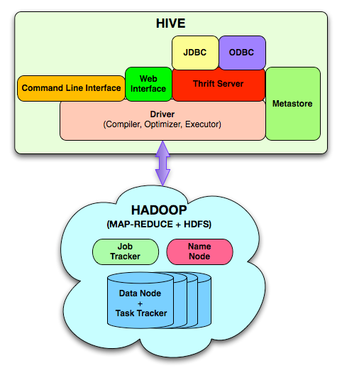
Hive architecture
Metastore: stores system catalog
Driver: manages life cycle of HiveQL query as it moves thru’ HIVE; also manages session handle and session statistics
Query compiler: Compiles HiveQL into a directed acyclic graph of map/reduce tasks
Execution engines: The component executes the tasks in proper dependency order; interacts with Hadoop
HiveServer: provides Thrift interface and JDBC/ODBC for integrating other applications.
Client components: CLI, web interface, jdbc/odbc inteface
Extensibility interface include SerDe, User Defined Functions and User Defined Aggregate Function.

Slide 9
Architecture(Detailed)
Map Reduce
Web UI + Hive CLI + JDBC/ODBC
Browse, Query, DDL
User-defined Map-reduce Scripts
HDFS
Hive QL
Parser Planner Optimizer | Execution
UDF/UDAF
substr sum average
MetaStore
Thrift API
FileFormats
TextFile SequenceFile RCFile
SerDe
CSV Thrift Regex
http://www.slideshare.net/cloudera/hw09-hadoop-development-at-facebook-hive-and-hdfs

Slide 10
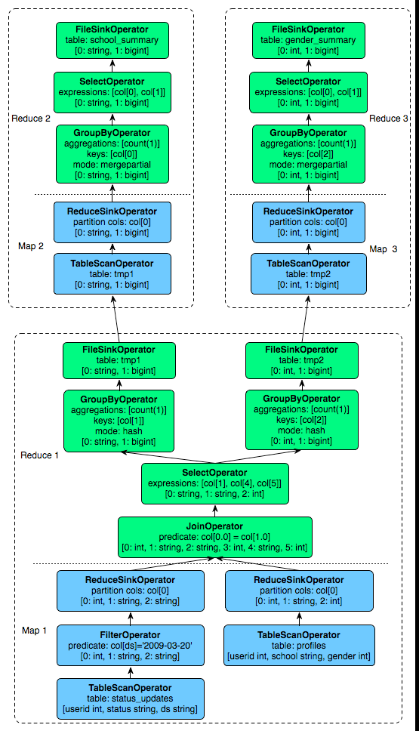
Sample Query Plan

Slide 11
Application
Log processing
Daily Report
User Activity Measurement
Data/Text mining
Machine learning (Training Data)
Business intelligence
Advertising Delivery
Spam Detection

Slide 12
Pros
Pros
A easy way to process large scale data
Support SQL-based queries
Provide more user defined interfaces to extend
Programmability
Efficient execution plans for performance
Interoperability with other database tools

Slide 13
Cons
Cons
No easy way to append data
Files in HDFS are immutable
Future work
Views / Variables
More operator
In/Exists semantic
More future work in the mail list

Slide 14
Hive Data Model
Data in Hive organized into :
Tables
Partitions
Buckets

Slide 15
Hive Data Model Contd.
Tables
Analogous to relational tables
Each table has a corresponding directory in HDFS
Data serialized and stored as files within that directory
Hive has default serialization built in which supports compression and lazy deserialization
Users can specify custom serialization –deserialization schemes (SerDe’s)

Slide 16
Hive Data Model Contd.
Partitions
Each table can be broken into partitions
Partitions determine distribution of data within subdirectories
Example -
CREATE_TABLE Sales (sale_id INT, amount FLOAT)
PARTITIONED BY (country STRING, year INT, month INT)
So each partition will be split out into different folders like
Sales/country=US/year=2012/month=12

Slide 17
Hierarchy of Hive Partitions
/hivebase/Sales
/country=US
/country=CANADA
/year=2012
/year=2012
/year=2015
/year=2014
/month=12
/month=11
/month=11
File
File
File
Notes:
Partitioned tables can be created using the PARTITIONED BY clause. A table can have one or more partition columns and a separate data directory is created for each distinct value combination in the partition columns. Further, tables or partitions can be bucketed using CLUSTERED BY columns, and data can be sorted within that bucket via SORT BY columns. This can improve performance on certain kinds of queries.

Slide 18
Hive Data Model Contd.
Buckets
Data in each partition divided into buckets
Based on a hash function of the column
H(column) mod NumBuckets = bucket number
Each bucket is stored as a file in partition directory

Slide 19
HiveQL
DDL :
CREATE DATABASE
CREATE TABLE
ALTER TABLE
SHOW TABLE
DESCRIBE
DML:
LOAD TABLE
INSERT
QUERY:
SELECT
GROUP BY
JOIN
MULTI TABLE INSERT
Notes:
The EXTERNAL keyword lets you create a table and provide a LOCATION so that Hive does not use a default location for this table. This comes in handy if you already have data generated. When dropping an EXTERNAL table, data in the table is NOT deleted from the file system.

Slide 20
Hive SerDe
SELECT Query
Hive built in Serde:
Avro, ORC, Regex etc
Can use Custom SerDe’s (e.g. for unstructured data like audio/video data, semistructured XML data)
Record Reader
Deserialize
Hive Table
Hive Row Object
Object Inspector Map Fields
End User

Slide 21
Data model.. cont
It supports primitive types: integers, floats, doubles, and strings
Hive also supports complex types:
associative arrays: map<key-type, value-type>
Lists: list<element type>
Structs: struct<file name: file type…>
SerDe: serialize and deserialized API is used to move data in and out of tables

Slide 22
Query Language (HiveQL)
Subset of SQL
Meta-data queries
Limited equality and join predicates
No inserts on existing tables (to preserve worm property)
Can overwrite an entire table

Slide 23
Data Storage
Tables are logical data units; table metadata associates the data in the table to hdfs directories.
Hdfs namespace: tables (hdfs directory), partition (hdfs subdirectory), buckets (subdirectories within partition)
/user/hive/warehouse/test_table is a hdfs directory

Slide 24

Hive Usage @ Facebook
Statistics per day:
4 TB of compressed new data added per day
135TB of compressed data scanned per day
7500+ Hive jobs on per day
Hive simplifies Hadoop:
~200 people/month run jobs on Hadoop/Hive
Analysts (non-engineers) use Hadoop through Hive
95% of jobs are Hive Jobs
http://www.slideshare.net/cloudera/hw09-hadoop-development-at-facebook-hive-and-hdfs

Slide 25

Hive v/s Pig
Similarities:
Both High level Languages which work on top of map reduce framework
Can coexist since both use the under lying HDFS and map reduce
Differences:
Language
Pig is a procedural ; (A = load ‘mydata’; dump A)
Hive is Declarative (select * from A)
Work Type
Pig more suited for adhoc analysis (on demand analysis of click stream
search logs)
Hive a reporting tool (e.g. weekly BI reporting)
Notes:
Declarative programming is where you say what you want without having to say how to do it. e.g SQL, yacc, lex
With procedural programming, you have to specify exact steps to get the result. e.g. C

Slide 26
Hive v/s Pig
Differences:
Users
Pig – Researchers, Programmers (build complex data pipelines,
machine learning)
Hive – Business Analysts
Integration
Pig - Doesn’t have a thrift server(i.e no/limited cross language support)
Hive - Thrift server
User’s need
Pig – Better dev environments, debuggers expected
Hive - Better integration with technologies expected(e.g JDBC, ODBC)
Notes:
Declarative programming is where you say what you want without having to say how to do it. e.g SQL, yacc, lex
With procedural programming, you have to specify exact steps to get the result. e.g. C

Slide 27
Hive Commands Practise
https://www.ukdataservice.ac.uk/media/604456/hiveworkshoppractical.pdf

Slide 28
In Class Exercise
Part 1

Slide 29
Hive Commands Use Case: Petrol
Dataset: https://drive.google.com/open?id=0B1QaXx7tpw3SMTBqLUQwX0lOWnM
ColumnNO. | Name | Example | DataType
Column1: | District.ID | I4N 1M1 | varchar
Column2: , | Distributor name | shell | varchar
Column3: | Buy rate (million) | $957.70 | varchar
Column4: | Sell rate(million) | $5779.92 | varchar
Column5: | volumeIN(millioncubic litter) | 933 | int
Column6: | volumeOUT(millioncubic litter) | 843, | int
Column7: | Year | 1624 | int

Slide 30
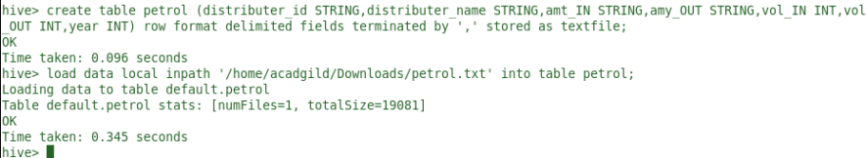
Hive Commands Use Case - Petrol
Creation of Table in Hive and Loading of data
create table petrol (distributer_id STRING,distributer_name STRING,amt_IN STRING,amy_OUT STRING,vol_IN INT,vol_OUT INT,year INT) row format delimited fields terminated by ‘,’ stored as textfile; load data local inpath ‘/home/acadgild/Downloads/petrol.txt’ into table petrol;

Slide 31
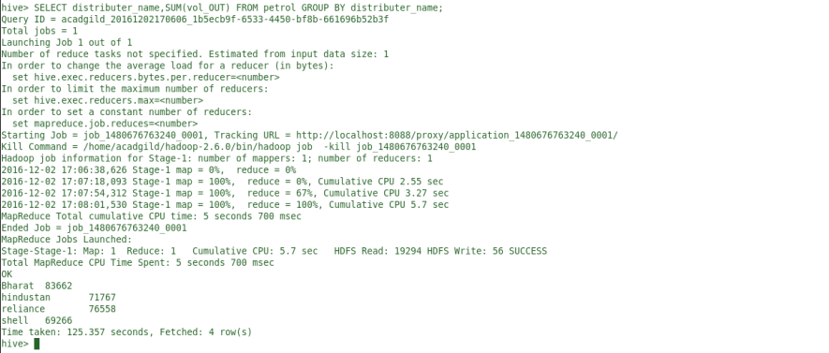
Hive Commands Use Case - Petrol
1)In real life what is the total amount of petrol in volume sold by every distributor? SELECT distributer_name,SUM(vol_OUT) FROM petrol GROUP BY distributer_name;

Slide 32
Hive Commands Use Case - Petrol
1)In real life what is the total amount of petrol in volume sold by every distributor? SELECT distributer_name,SUM(vol_OUT) FROM petrol GROUP BY distributer_name;

Slide 33
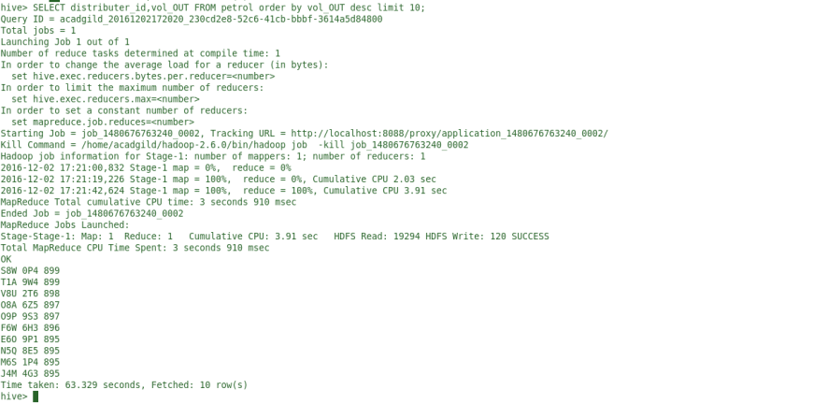
Hive Commands Use Case - Petrol
2)Which are the top 10 distributors ID’s for selling petrol and also display the amount of petrol sold in volume by them individually? SELECT distributer_id,vol_OUT FROM petrol order by vol_OUT desc limit 10;

Slide 34
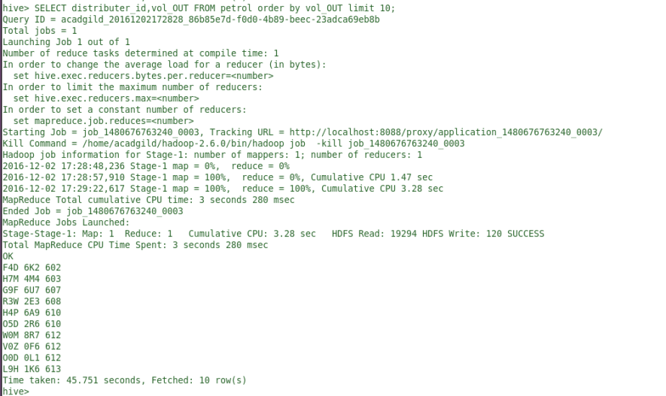
Hive Commands Use Case - Petrol
3)Find real life 10 distributor name who sold petrol in the least amount. SELECT distributer_id,vol_OUT FROM petrol order by vol_OUT limit 10;

Slide 35
Hive Commands Use Case - Petrol
4)Try One yourself
The constraint to this query is the difference between volumeIN and volumeOuT is illegal in real life if greater than 500. As we see all distributors are receiving patrols on every next cycle. List all distributors who have this difference, along with the year and the difference which they have in that year. Hint: (vol_IN-vol_OUT)>500

Slide 36
In Class Exercise
Part 2

Slide 37
Hive Commands Use Case - OLYMPICS
DATA SET: https://drive.google.com/file/d/0B1QaXx7tpw3SaEE3bEFTQTMzNzg/view?usp=sharing Olympic Data analysis using Hive
ColumnNO. | Name | Example | DataType
Column1: | AthleteName | Michael Phelps | STRING
Column2: , | Age | 23 | INT
Column3: | Country | United States | STRING
Column4: | Year | 2008 | INT
Column5: | Closing Date | 8/24/2008 | STRING
Column6: | Sport | Swimming | STRING
Column7: | Gold Medals | 8 | INT
Column8: | Silver Medals | 0 | INT
Column9: | Bronze Medals | 0 | INT
Column10: | Total Medals | 8 | INT

Slide 38
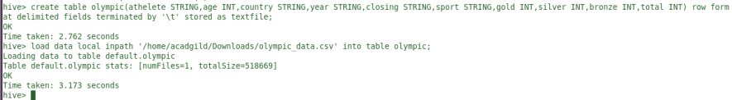
Hive Commands Use Case - OLYMPICS
Creation of Table in Hive and Loading of data
create table olympic (athelete STRING,age INT,country STRING,year STRING,closing STRING,sport STRING,gold INT,silver INT,bronze INT,total INT) row format delimited fields terminated by ‘\t’ stored as textfile; load data local inpath ‘/home/acadgild/Downloads/olympic_data.csv’ into table olympic;

Slide 39
Hive Commands Use Case - OLYMPICS
1) Using the dataset list the total number of medals won by each country in swimming.
select country,SUM(total) from olympic where sport = “Swimming” GROUP BY country;

Slide 40
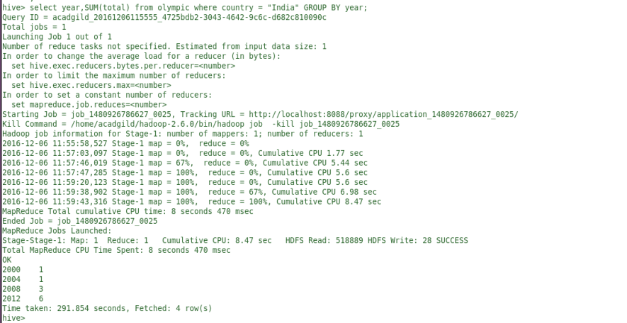
Hive Commands Use Case - OLYMPICS
2)Display real life number of medals India won year wise. select year,SUM(total) from olympic where country = “India” GROUP BY year

Slide 41
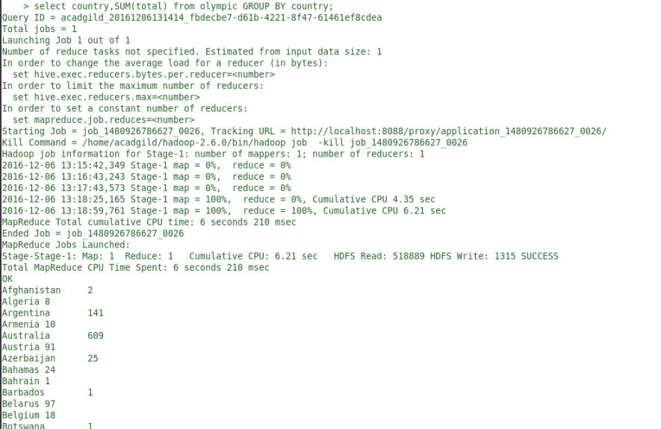
Hive Commands Use Case - OLYMPICS
3)Find the total number of medals each country won display the name along with total medals. select country,SUM(total) from olympic GROUP BY country;

Slide 42
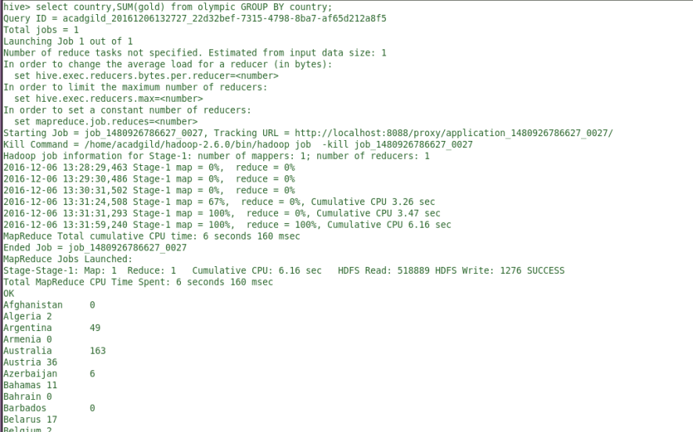
Hive Commands Use Case - OLYMPICS
4)Find the real life number of gold medals each country won. select country,SUM(gold) from olympic GROUP BY country;

Slide 43
Hive Commands Use Case - OLYMPICS
5)Try One yourself
Which country got medals for Shooting, year wise classification?

Slide 44
In Class Exercise
Part 3

Slide 45
Hive Commands Use Case - MovieLens
DataSet
https://umkc.box.com/s/m3i7oabkj00boxuiskv5d4aoklh85w3x
Three datasets:
Movies
Users
Ratings

Slide 46
Task
Perform the following tasks:
Create 3 tables called movies, ratings and users. Load the data into tables.
For movies table:
List all movies with genre of movie is “Action” and “Drama”
For Ratings table:
List movie ids of all movies with rating equal to 5.
Find top 11 average rated "Action" movies with descending order of rating.
( Hint: Need to perform join operation on Movies and Ratings table)

Slide 47
Reference
A.Thusoo et al. Hive: a warehousing solution over a map-reduce framework. Proceedings of VLDB09', 2009.
Hadoop 2009:
http://www.slideshare.net/cloudera/hw09-hadoop-development-at-facebook-hive-and-hdfs
Facebook Data Team:
http://www.slideshare.net/zshao/hive-data-warehousing-analytics-on-hadoop-presentation
Hive Examples:
https://umkc.box.com/s/1dcugk08caqzitgqvrthiqe5n6sgznd5

